Slide 1

Point clouds Compression
Lin Zhang (lzhang50@usc.edu)

Slide 2
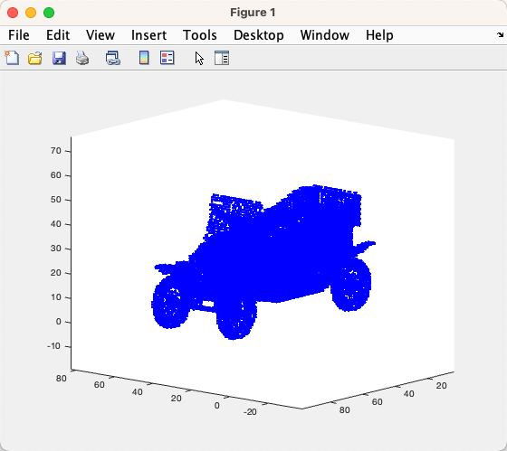
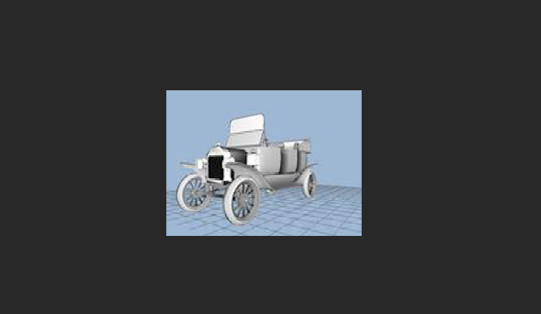
1 Why?
Figure 1: Princeton Shape Benchmark
Figure 2: https://github.com/shahramg/FLS-Multimedia2022

Slide 3
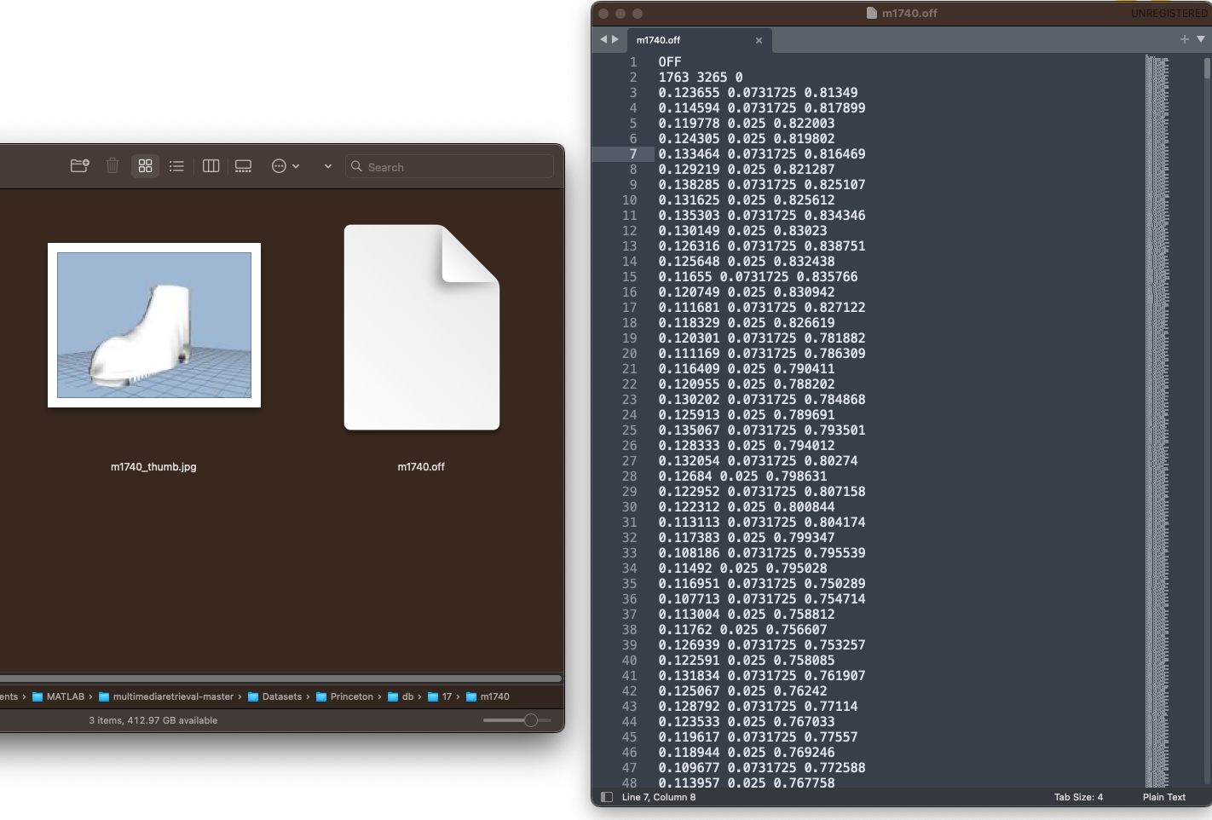
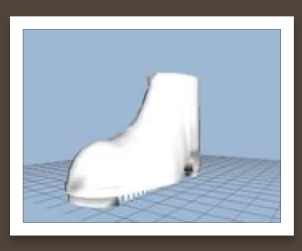
Princeton Shape Benchmark
Connectivity info
Geometry info

Slide 4


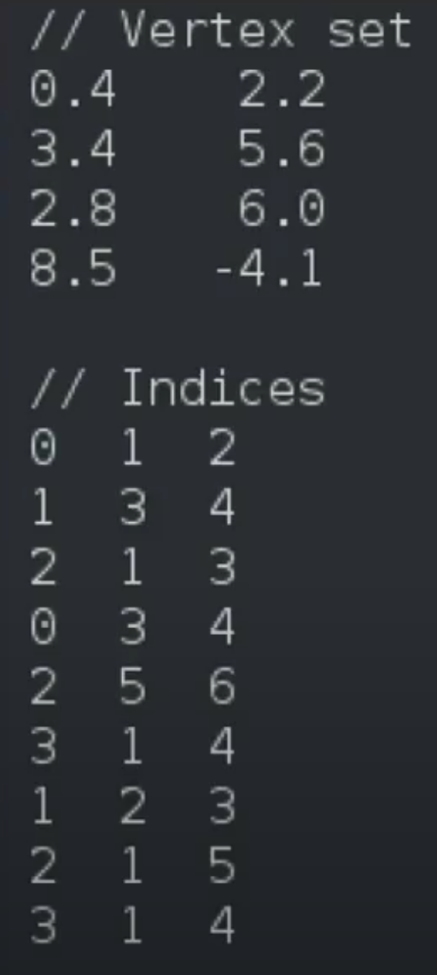
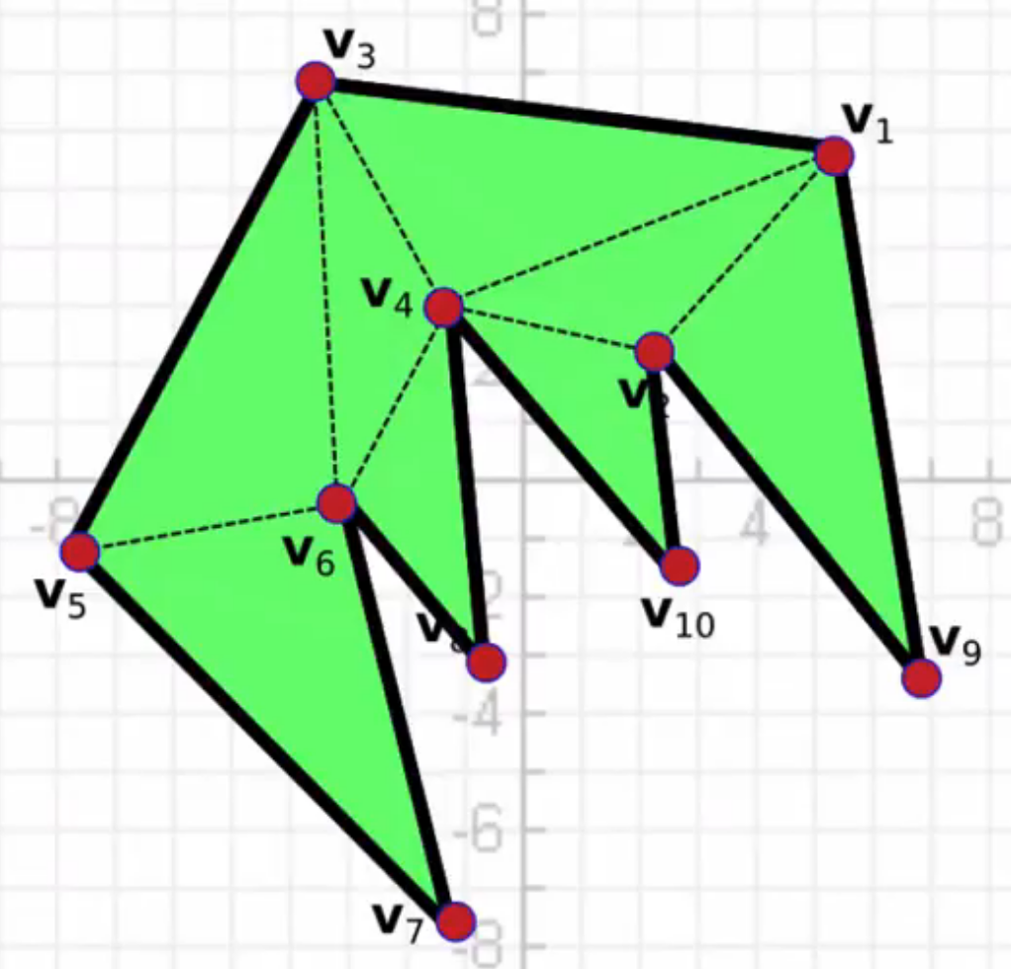
Connectivity
one example:
Geometry
optimize

Slide 5
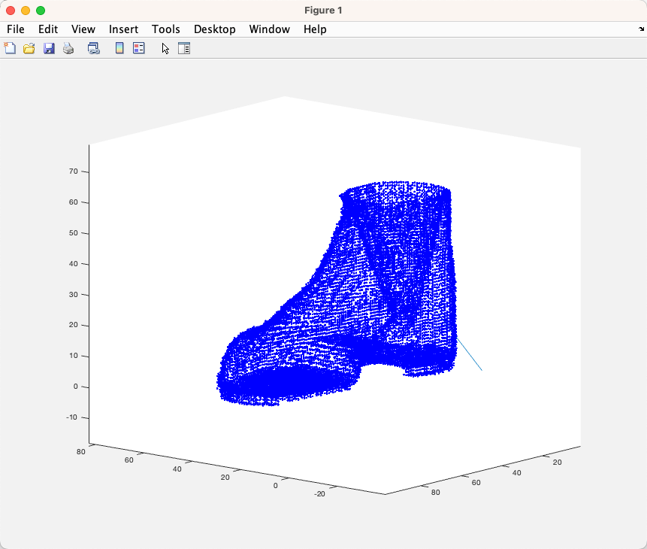
Dataset to point cloud
Ref: https://github.com/shahramg/FLS-Multimedia2022
cnvPrincetonShapeToPtCld('$PATH_OF_DATASET', 'OUTPUT_FIle')
plotPtCld('./OUTPUT_FIle')
Example:
cnvPrincetonShapeToPtCld('~/Datasets/Princeton/db/17/m1740/m1740.off', './pt17400.ptcld')
plotPtCld('./pt17400.ptcld')

Slide 6
Without point cloud compression:
Count: 16k vertices (16231)
Run-time: 2~3 seconds

Slide 7
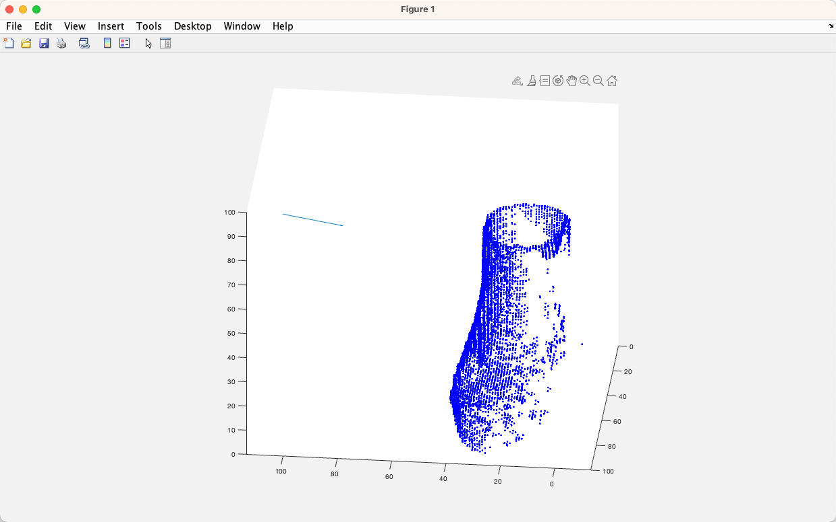
With point cloud compression:
Vertices : 16k -> 5k (5190)
Run-time: 5 mins
Ray tracing: 15816
Eye position: [100 100 100] //[x y z]

Slide 8
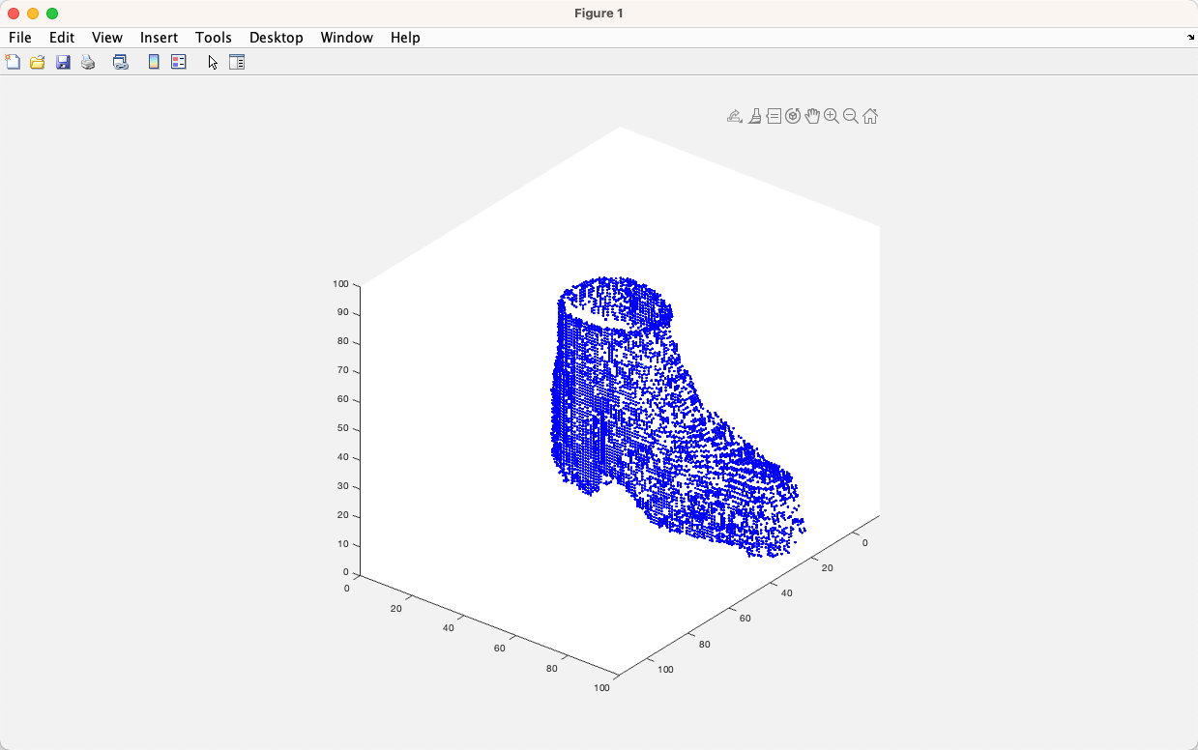
Point cloud compression algorithm
Github: https://github.com/LIN251/CompressionOfPointClouds
pointCloudCompression('$PATH_OF_DATASET', 'OUTPUT_FIle', EYE_POSITION)
plotPtCld('./OUTPUT_FIle')
Example:
pointCloudCompression('~/Datasets/Princeton/db/17/m1740/m1740.off', './pt17400.ptcld', [100 100 100])
plotPtCld('./pt17400.ptcld')

Slide 9
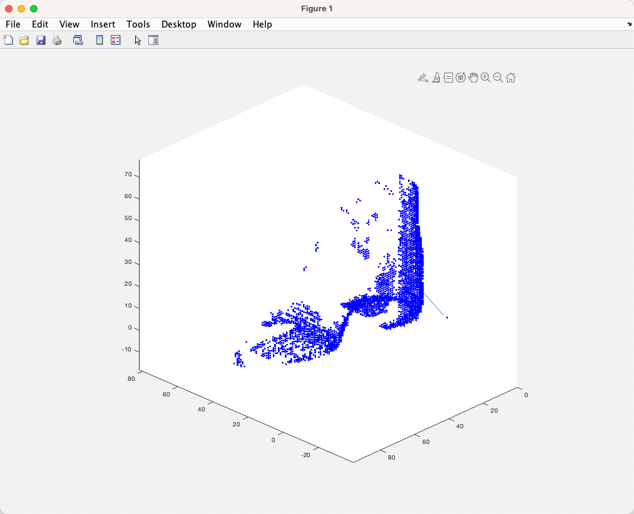
Example:
With point cloud compression:
Vertices : 16k -> 3k (3408)
Run-time: 2.5 mins
Ray tracing: 15566
Eye position: [1 1 1] //[x y z]

Slide 10
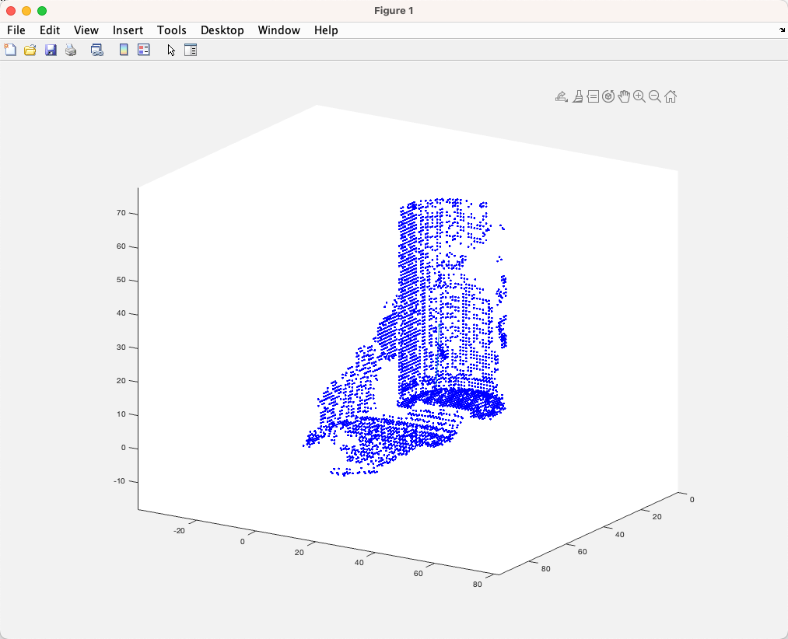

Point cloud compression algorithm
Github: https://github.com/LIN251/CompressionOfPointClouds
pointCloudCompression('$PATH_OF_DATASET', 'OUTPUT_FIle', EYE_POSITION)
plotPtCld('./OUTPUT_FIle')
Example:
pointCloudCompression('~/Datasets/Princeton/db/17/m1740/m1740.off', './pt1741.ptcld', [1 1 1])
plotPtCld('./pt1741.ptcld')

Slide 11
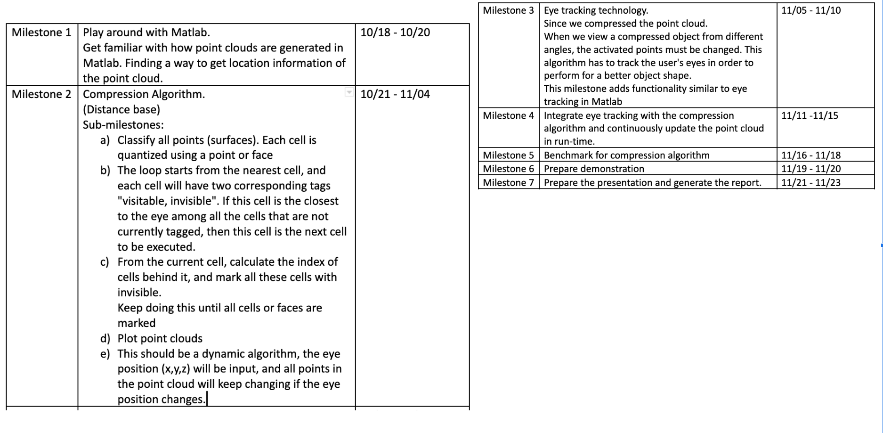

Slide 12
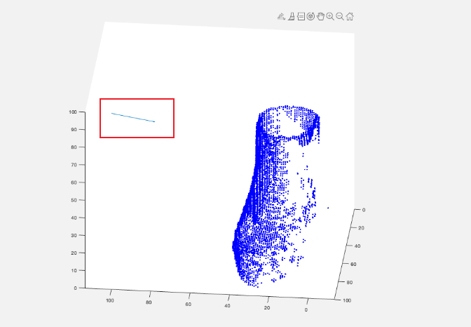
pointCloudCompression('~/Datasets/Princeton/db/17/m1740/m1740.off', './pt1741.ptcld' , [1 1 1])
-> center of point cloud
plotPtCld('./pt1741.ptcld', [1 1 1], [0.3433 0.4904 0.8010])
Matlab: R2022b (9.13.0.2049777) August 24,2022
Github: https://github.com/LIN251/CompressionOfPointClouds

Slide 13
Point Cloud Compression Algorithm
Eye position
Calculate Ray direction
Calculate Unit vector from eye to each point in the point cloud
Scalar quantization (trade off between runtime and accurate)
Unique ray direction
Ray tracing (Ray-AABB Intersection Algorithm):
Calculate the bounding cube (BC) of the point cloud (max and min point)
Calculate the intersection point(x) of the ray and the surface of the BC
Extend the ray from human eye to x until it hits a point in the point cloud
Return if rays beyond BC
Return if the ray has penetrated the BC and has not hit any usable point
Return after hitting the first point
4. Mark first visitable vertex
5. Mark all neighbor of the current vertex ( x <= 6 neighbors)
6. Loop through all rays
7. Generate new point cloud

Slide 14
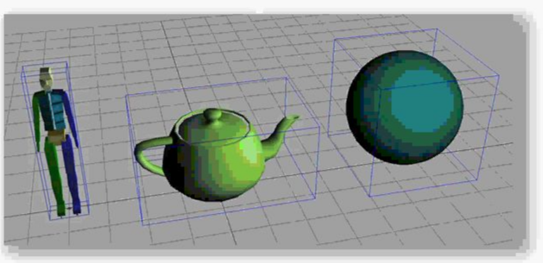
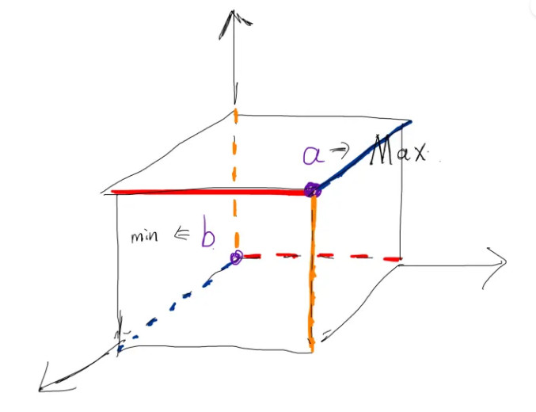
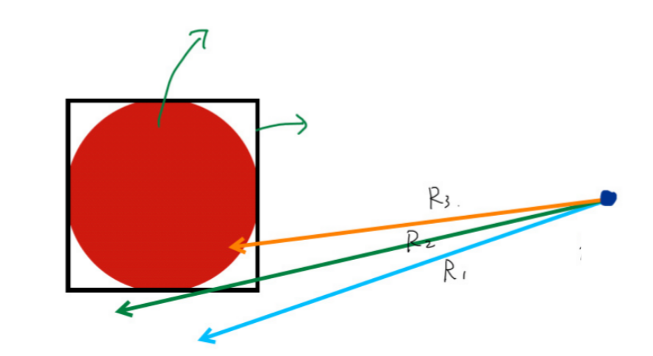

R1: If the ray doesn't hit the boundary, then it must not hit the point cloud
R2: If the ray hits the boundary then there is a chance it did not hit the point cloud
R3: If the ray hits the boundary then it has a chance of hitting the point cloud

Slide 15
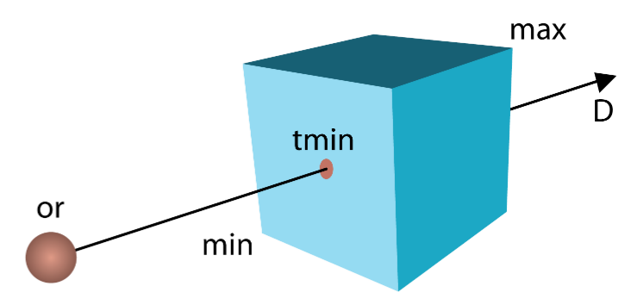
Ray tracing equation
R(t)=O+t∗D
t_x = (R(t) - O.x) / Dir.x
t_y = (R(t) - O.y) / Dir.y
t_z = (R(t) - O.z) / Dir.z
The plane equation is
aX+bY+cZ+d=0
Six faces of a AABB cube. They are parallel to the XY, XZ, YZ planes.
so the plane equations are X=d, Y=d, Z=d. In this case, the intersection point R(tins) on the plane:
When the ray intersects two faces perpendicular to the x-axis,
t_x0 = (d - O.x) / Dir.x
When the ray intersects two faces perpendicular to the y-axis,
t_y0 = (d - O.y) / Dir.y
When a ray intersects two faces perpendicular to the z-axis,
t_z0 = (d - O.z) / Dir.z
First hit: (t_x0, t_y0, t_z0)
Second hit: (t_x1, t_y1, t_z1)

Slide 16
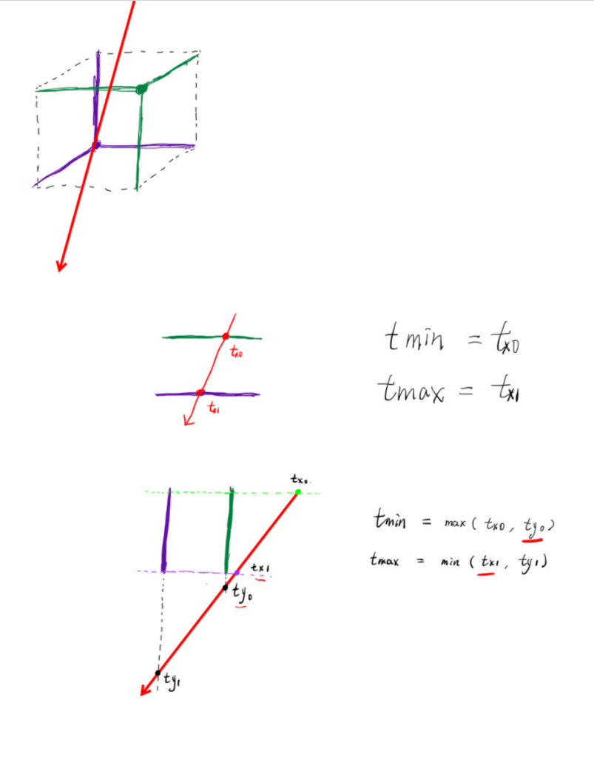
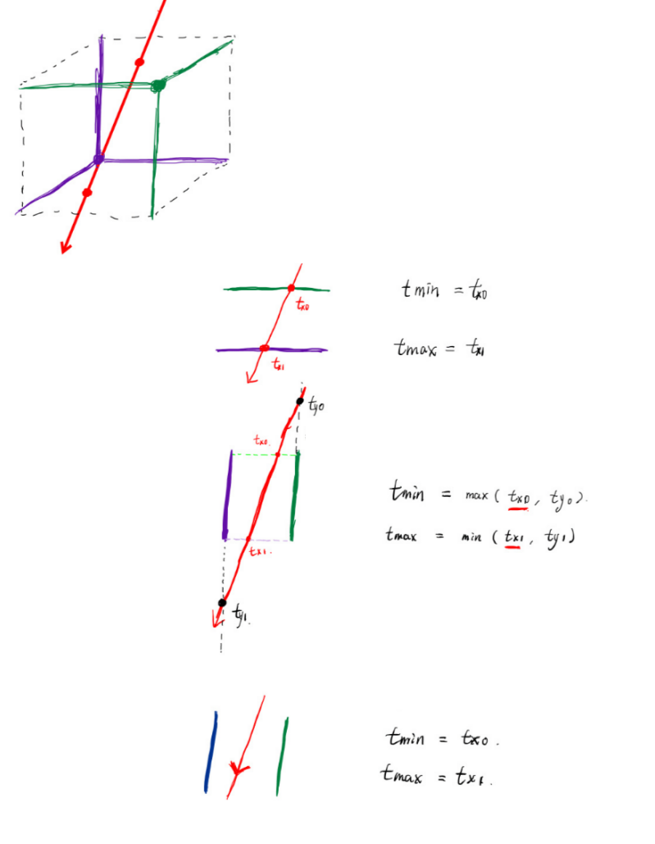
light hits
light miss
X axis direction
X axis direction
Y axis direction
Y axis direction
Z axis direction
t_min > t_max, so no intersection
Z axis direction

Slide 17
Thank you

